Slide 1




DATABASE SYSTEM Presentation
Presented to = Ma’am Sadia Zafar
Presented By = Azfar Asif -023

Slide 2






Our Team
Azfar Asif 023

Slide 3




Table of Content
What is Database?
Database management
Introduction Flight Reservation System
Benefits
Problem
Entities
Project Timeline
ERD

Slide 4
DATABASE
A Collection of logical related data which can be easily accessed
Data is stored in tables in rows and columns

Slide 5

DATABASE MANAGEMENT
A DATABASE Management system (DBMS) is a system software
Creating and managing DATABASES
In which files are integrated to each other
Use of this system increases efficiency of business operations

Slide 6
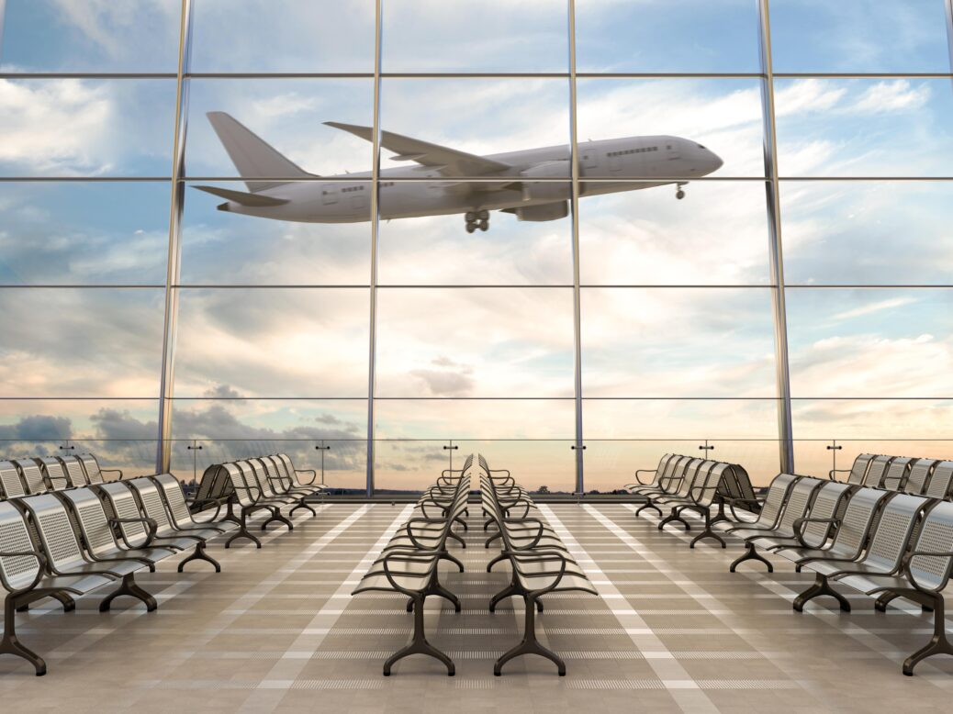
INTRODUCTION OF FLIGHT RESERVATION SYSTEM
We use DBMS in Flight Reservation system
We identify the entities , attributes, and relationships.

Slide 7


BENEFITS
Highly Customizable System.
It removes duplication of data
Easy to insert, update or delete DATA
Seamless, fast and error free

Slide 8
Target audience worldwide
Travellers
Travel Agencies

Slide 9
Problems
Security
High Maintenance cost
Complexity
Storage Issue
Low & Buggy
Duplication of Data
Data Dependency

Slide 10
Entities
Flight Manager
Meal
Travellers
Airplane
Flight

Slide 11
 | PROJECT TIMELINE FOR FLIGHT RESERVATION SYSTEM
 |  |  |  |  |  | February 1 – February 13, 2022
 |  |  |  |  |  | w1 | w2 | w3 | w4 | w5 | w6 | w7 | w8 | w9 | w10 | w11 | w12
 | Think about Project
 | Market research
 | Think Project Name
 | Making Class Diagram
 | Making ERD
 | Identify Problem
 | Entities
 | Making Tables
 | Making Triggers
 | Inserting Data
 | Making SRS
 | Final the Project

Slide 12
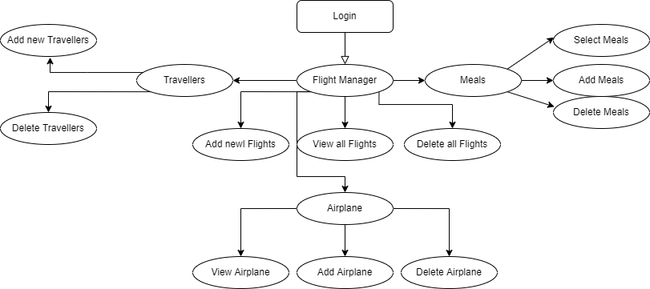

Slide 13
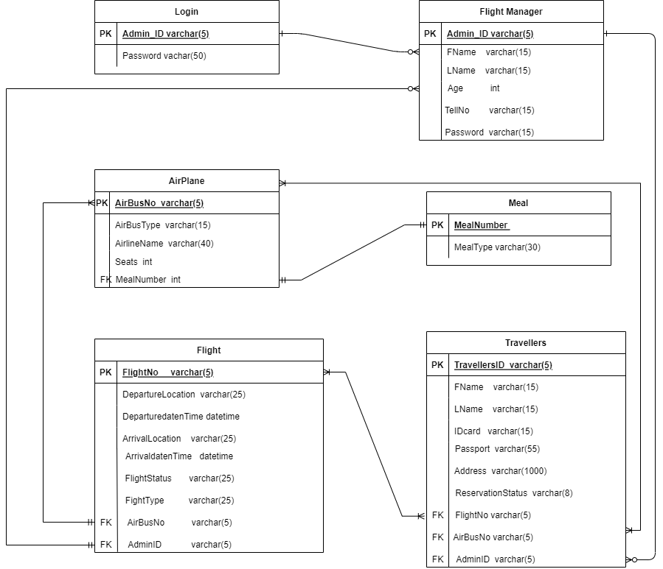
ERD

Slide 14
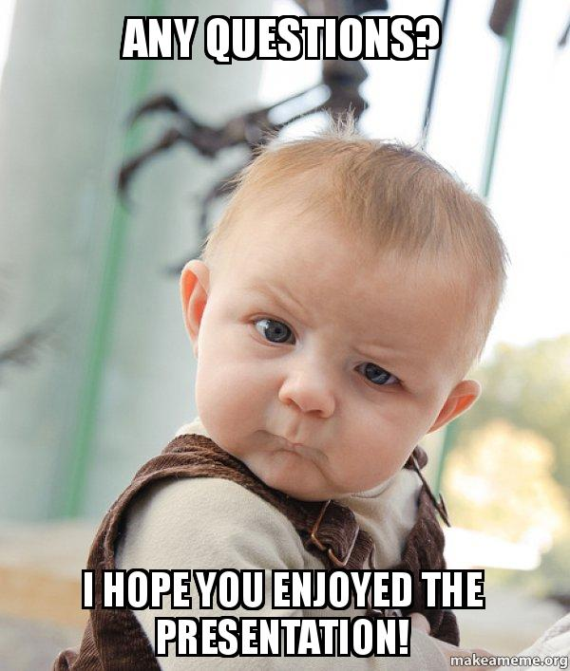

Slide 15
